Slide 1
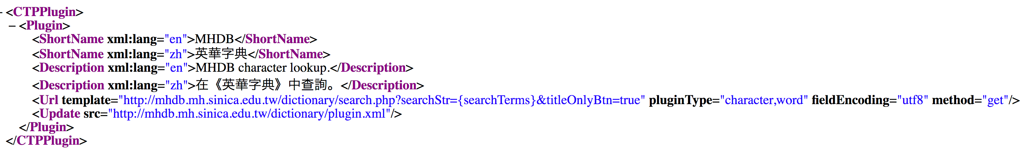
Cyberinfrastructure in practice
Donald Sturgeon
Harvard University
sturgeon@fas.harvard.edu

Slide 2
Overview
Infrastructure
  What it is and why it matters
Application Programming Interfaces (APIs)
  Simple examples in widespread use
  Current examples in Chinese studies
    Chinese Text Project (ctext.org) API
Questions and challenges going forward
  What infrastructure do we need
  How are we going to maintain it

Slide 3
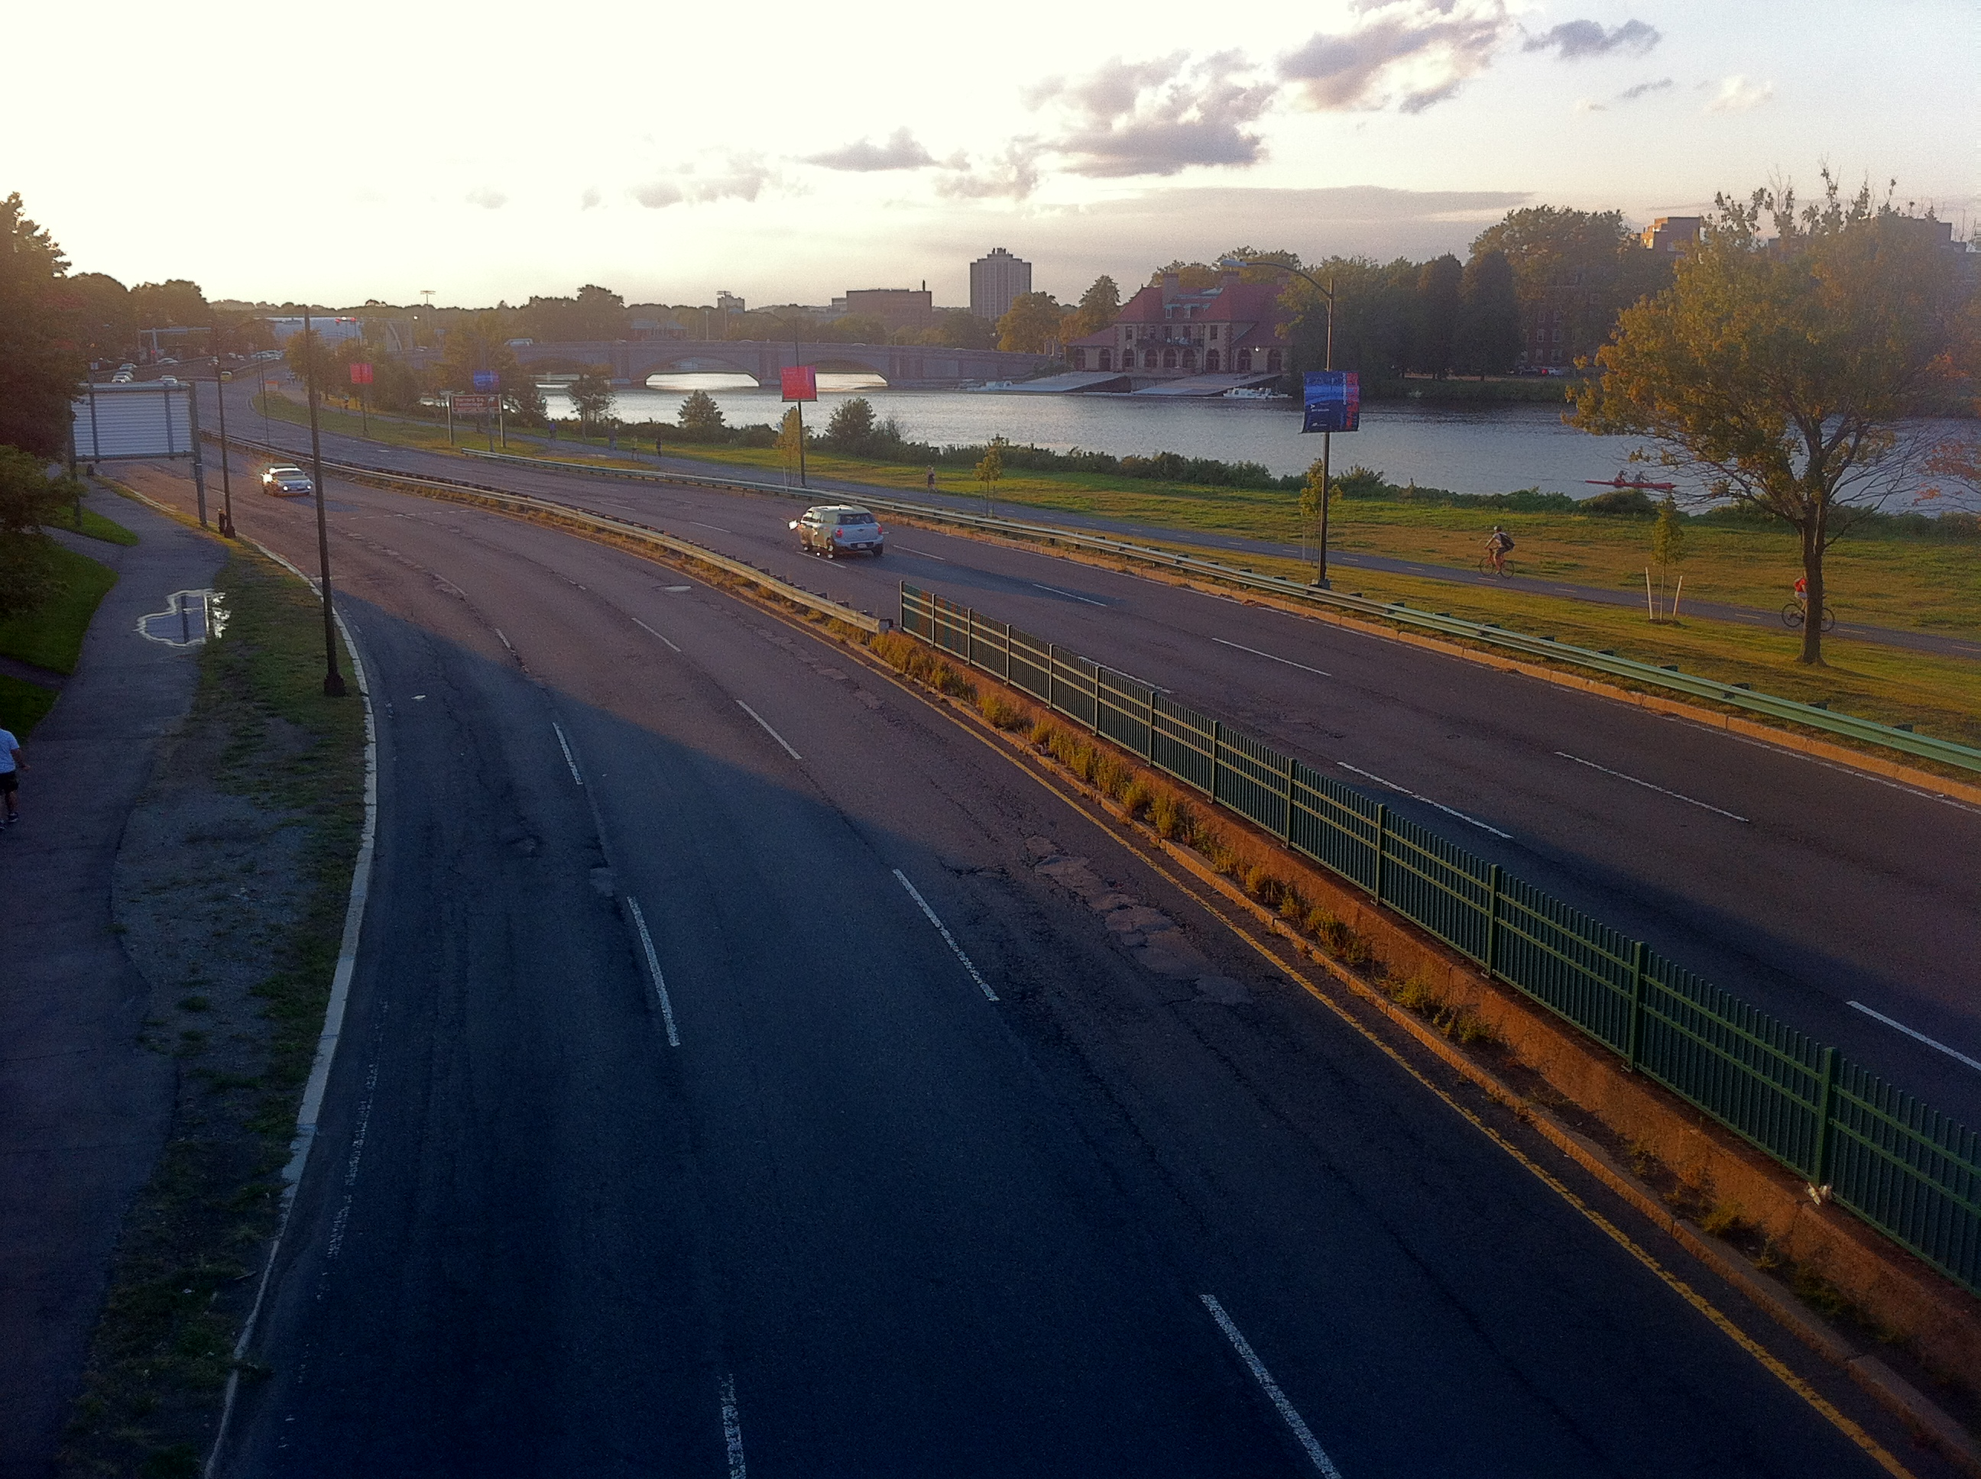
Infrastructure
Is instrumental
  Not an end but a means to an end
Makes the possible (but difficult) easier
Makes the impractical practical
Requires up-front investment
Requires ongoing maintenance

Slide 4






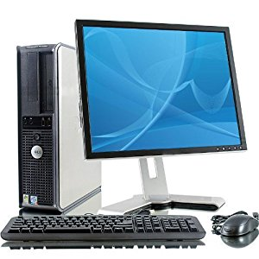
Infrastructure in the humanities
Domain-specific tools,
databases, etc.
Humanities research tools
Special-purpose
research infrastructures
?
ctext API
CBDB API
?
CTS
General-purpose infrastructures
Code Libraries
Software
Services
Standards
Low-level software infrastructure
General-purpose operating systems
“Real-world” infrastructure
Electricity, hardware, etc.

Slide 5
Types of humanities infrastructure
Data formats
  Text Encoding Initiative (TEI)
Application Programming Interfaces (APIs)
  IIIF Image API
Open source software and libraries
  Stanford CoreNLP
Services
  University Library provision of IIIF-compliant data

Slide 6
Application Programming Interfaces
What do they do?
  Predictable mechanisms for data exchange
  Increasingly: web APIs
What are they useful for?
  Making materials/services available in consistent way
    Abstraction from implementation details
  Allowing the creation of “derived products”
    “Mashups” consisting of independently maintained parts
    Mining and analysis of data
  “Offloading” part of the development process

Slide 7
Google Maps
Google Maps user interface
  Allows access to Google-defined services
Google Maps API
  Allows building upon Google’s map services
  Create things Google alone would never create

Slide 8
Google Maps + Housing Rental Data
Distribution of effort:
  Google:
    has no control over apartment data
    maintains map data and map interface
  Rental search company:
    has limited control over map data & interface
    maintains apartment rental information
Resulting mashup is nevertheless a cohesive product
  Works as if created by a single group
  In fact maintained by two independent groups

Slide 9
Google Maps + Disease Data
Economies of scale:
  Google:
    concentrates on one thing only: maps
  Other groups:
    concentrate on their own content
    benefit from centralization of map-related code & data
  Lower barriers to entry for subsequent projects
    Not a closed, one-off collaboration
    Instead: an open invitation to others to collaborate

Slide 10
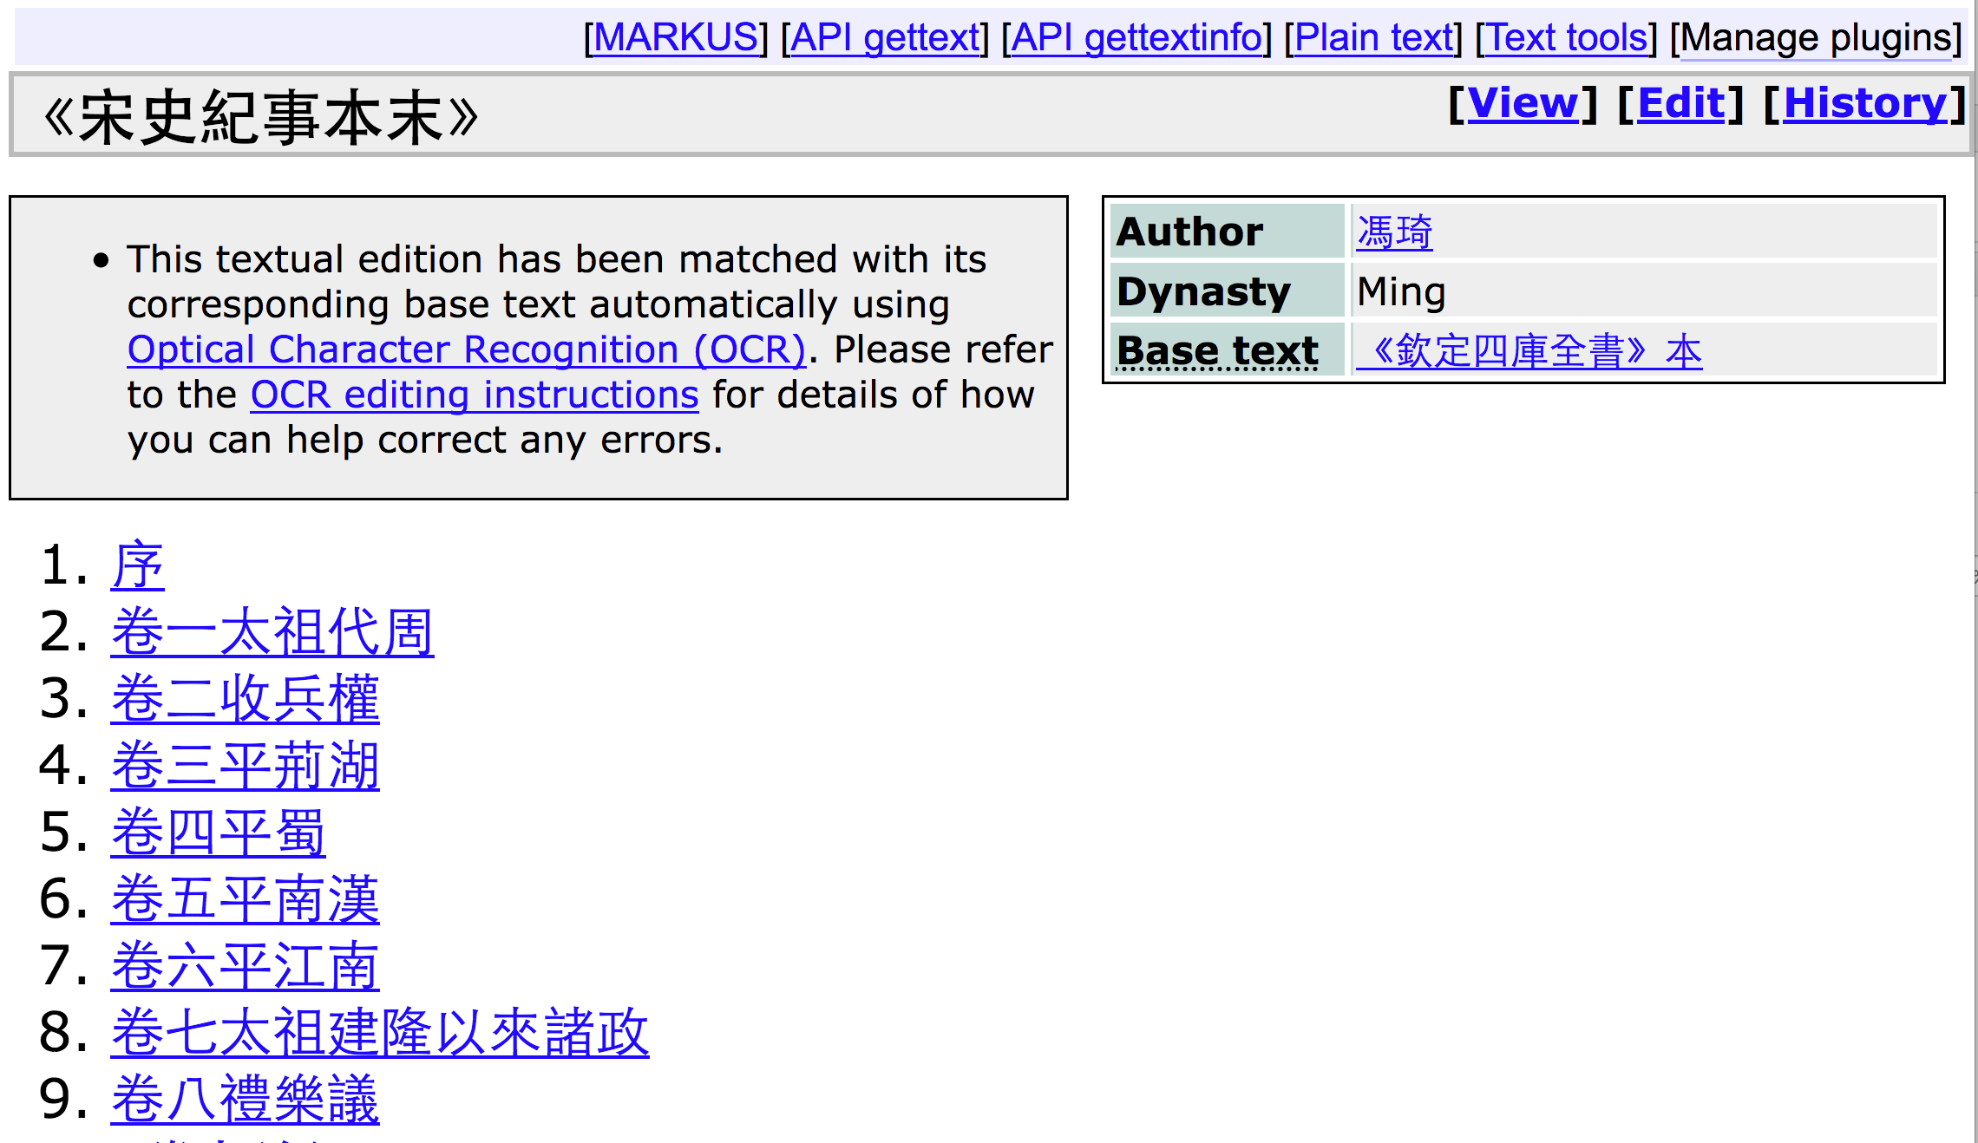
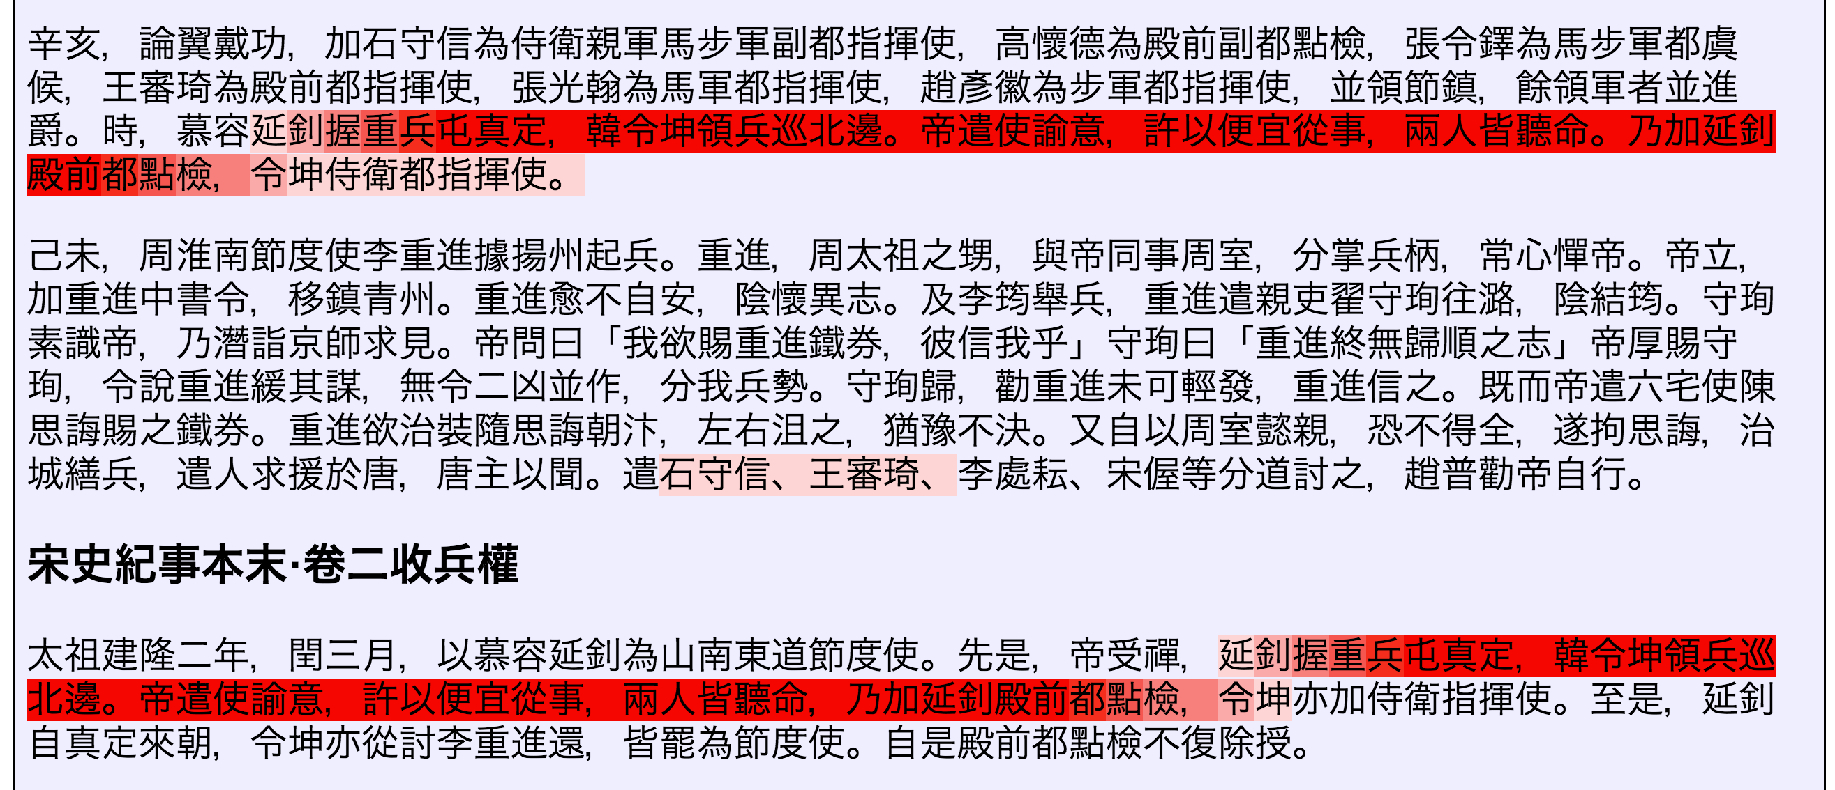
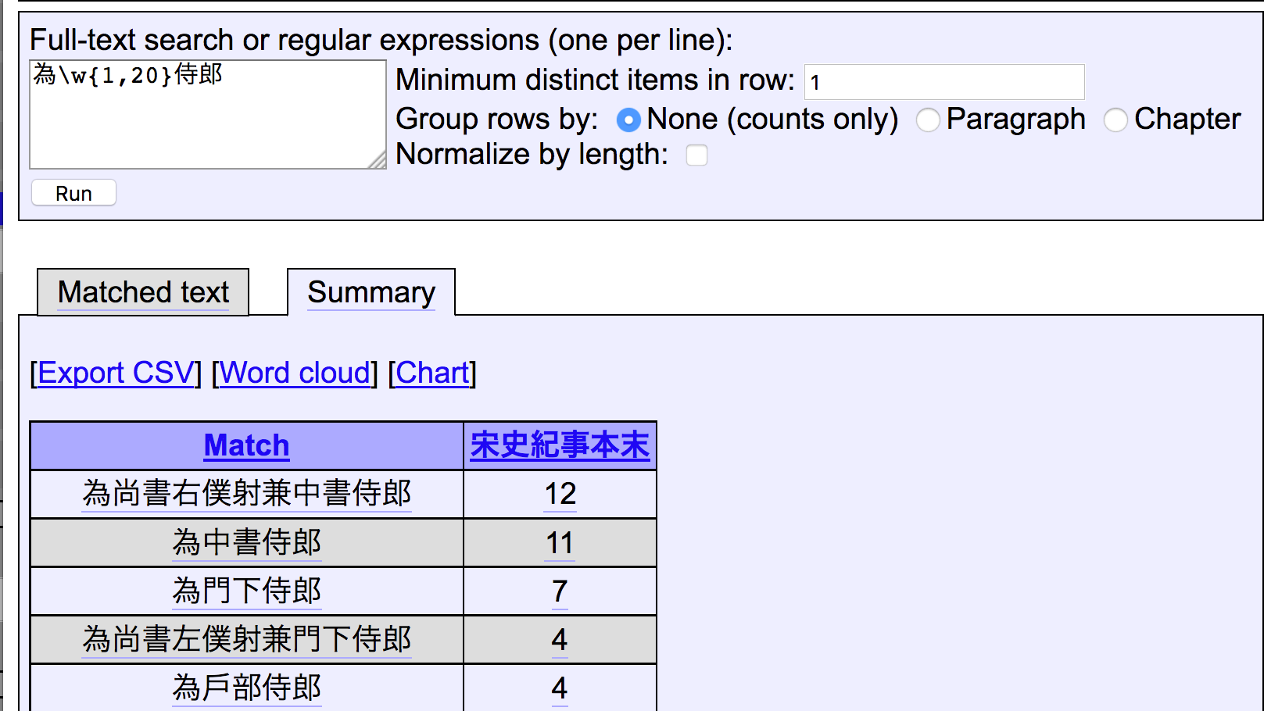
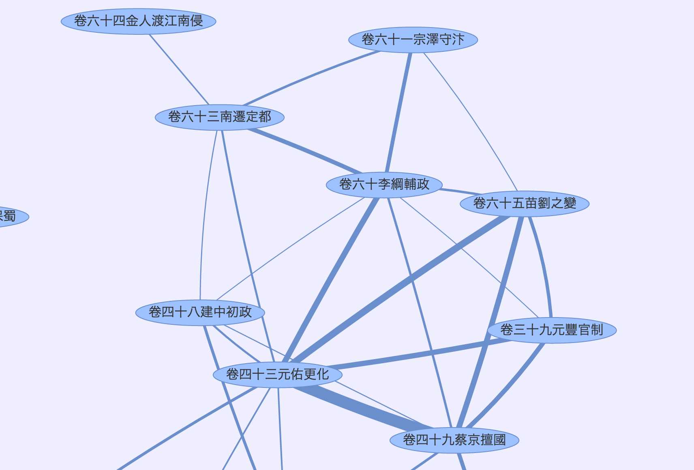
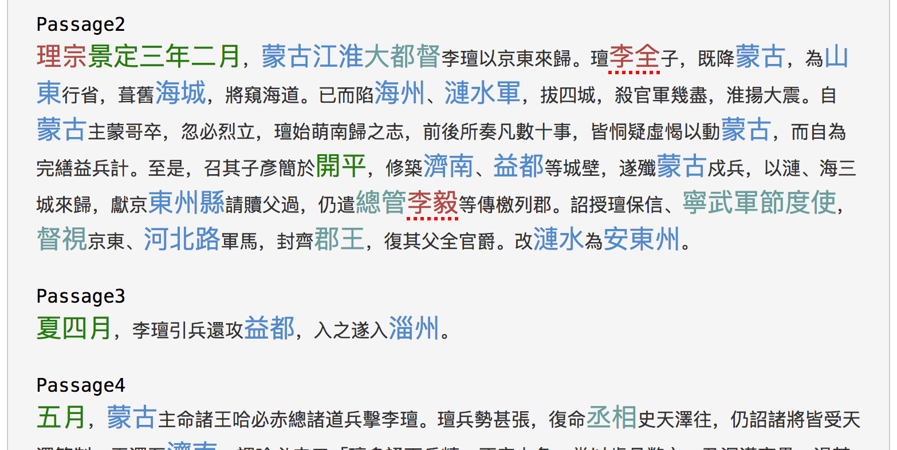
APIs in practice: ctext API

Slide 11
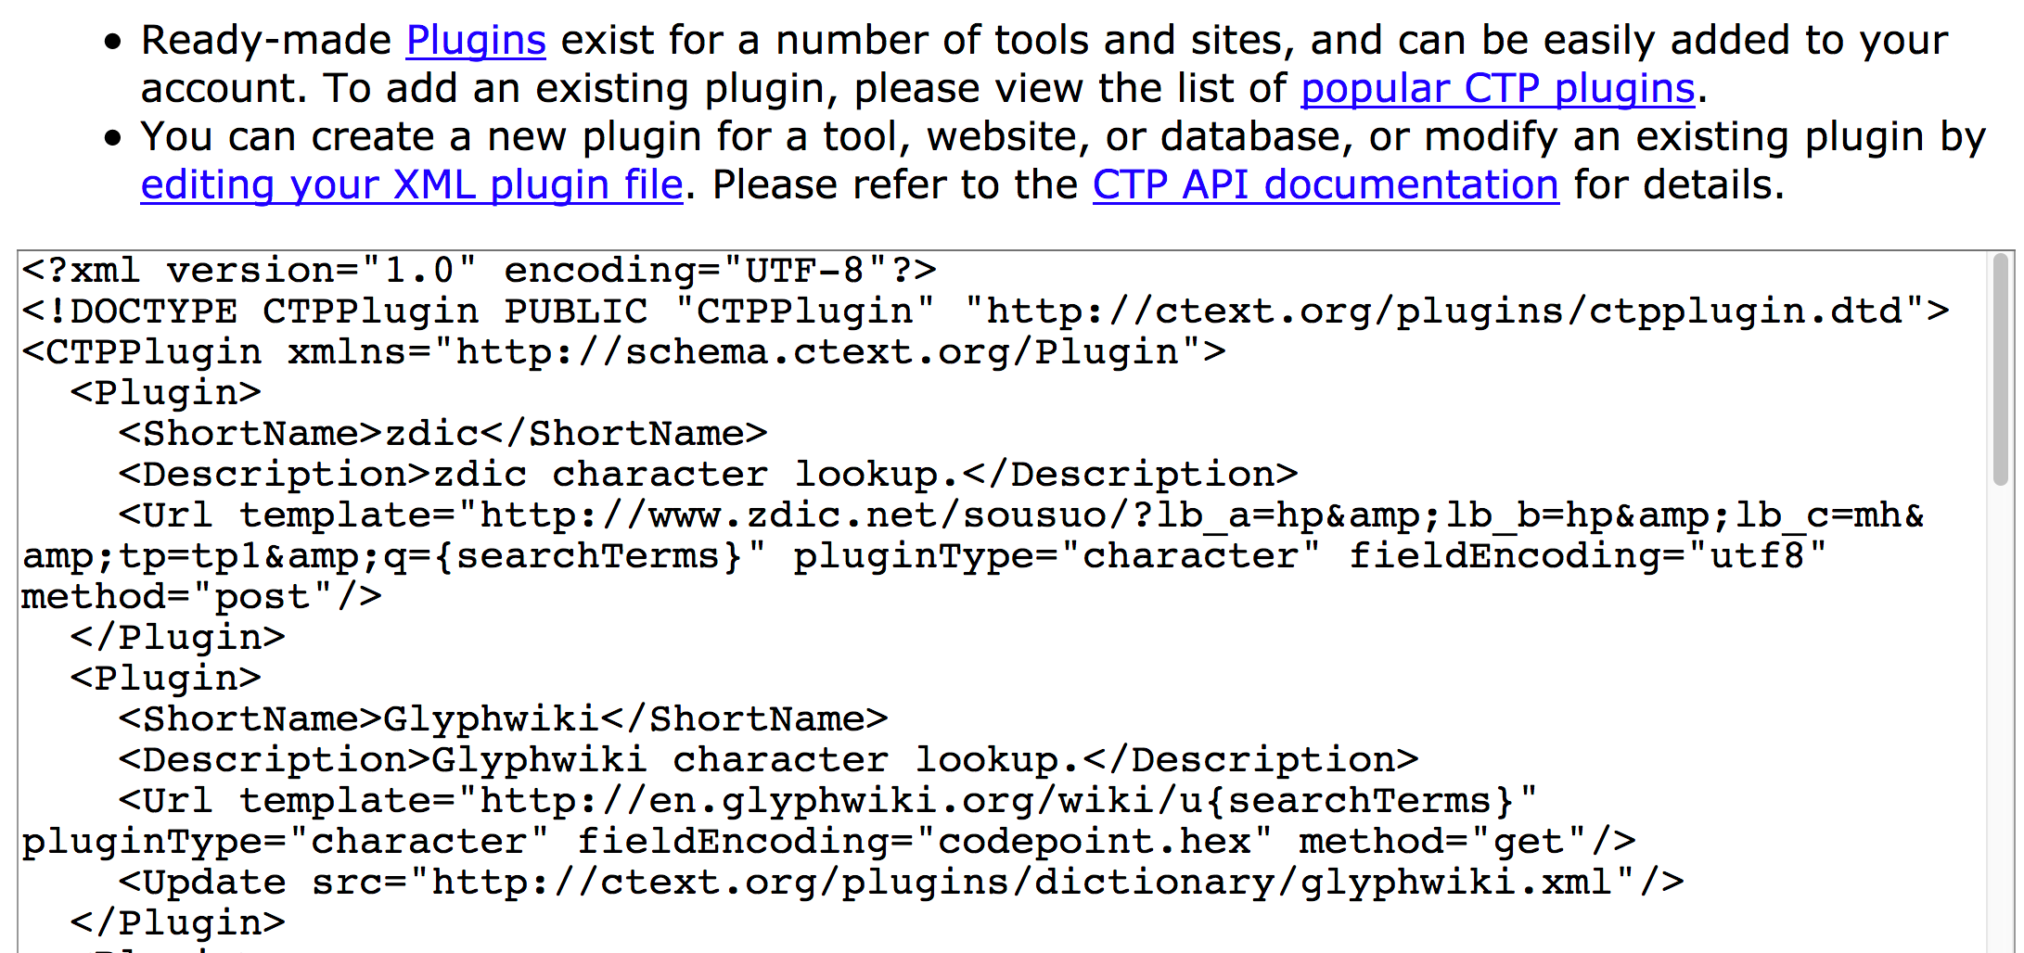
APIs in practice: ctext API
ctext, MARKUS, Text Tools, etc. all communicate via public API
  Everyone has access to the API and its documentation
Lowers barriers to entry for subsequent projects
  Not a closed, one-off collaboration
  Instead: an open invitation to others to collaborate
  Anyone can create and distribute a new API client / plugin

Slide 12
APIs in the humanities
How to create economies of scale
  What areas benefit from standardization
  What areas benefit from decentralization
How to let projects concentrate on core work
  Digital projects increasingly complex
  No single team can expect to do everything well
What infrastructure is most urgently needed
  Which components have greatest reuse potential

Slide 13
Cyberinfrastructure: challenges
Components need to be maintained over time
  How will this be guaranteed institutionally
Standardization is beneficial but not easy
  Humanities data is complex
  TEI is one example demonstrating this complexity
Cyberinfrastructure needs coordination
  Not just a function of a single group
  Many stakeholders
    Data creators, disseminators, consumers, end users, etc.

Slide 14
Thank you!

